Slide 1
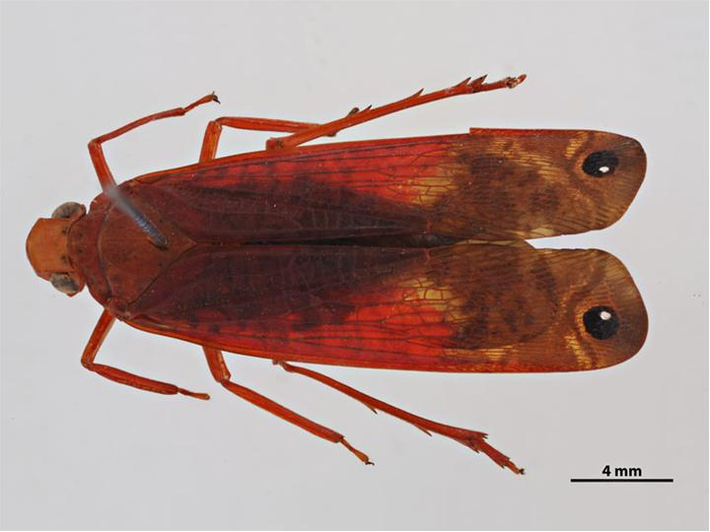
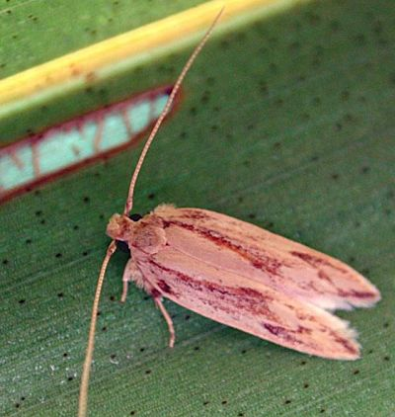
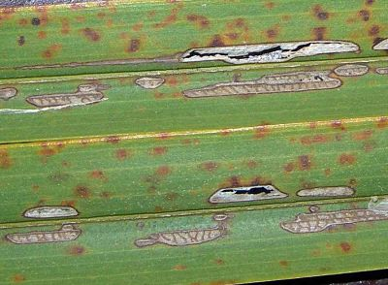
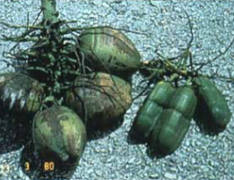
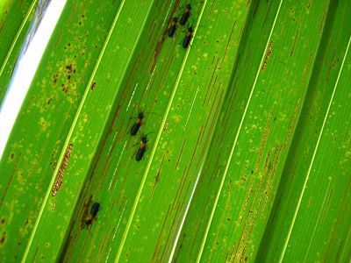
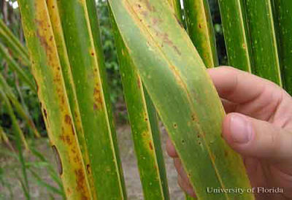
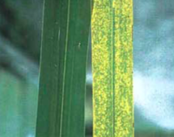
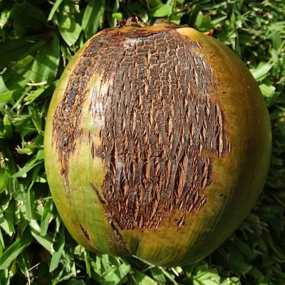
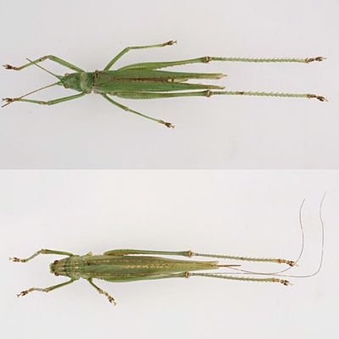
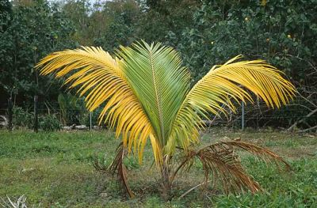
Some coconut pests and diseases – in the Pacific and elsewhere
Zophiuma, a carrier of Bogia coconut syndrome – a lethal yellowing disease – and symptoms
Coconut flat moth & feeding damage
Symptoms of Tinangaja disease
Coconut leaf miner and damage
Polynesian rat (kimoa), Black rat (a)and brown rat (b) and nut with rat damage
Red palm mite damage
Cadang-cadang disease symptoms
Coconut mite damage
Coconut sexava treehopper
Coconut bug and coconut & scarring damage
Myndus taffini vector of coconut foliar decay, and symptoms

Slide 2
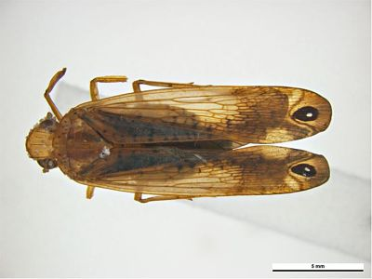
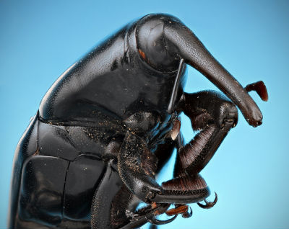
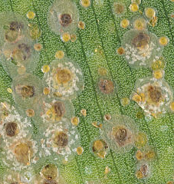
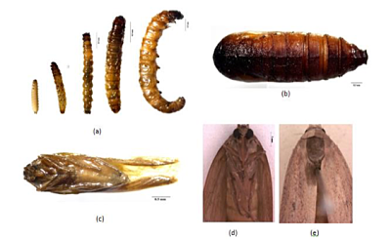
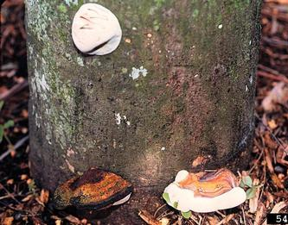
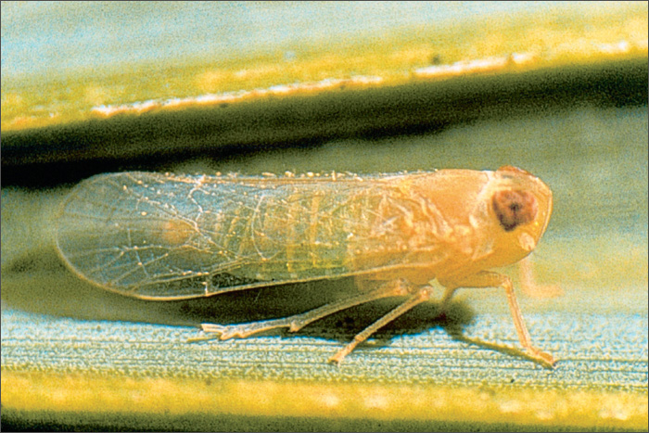
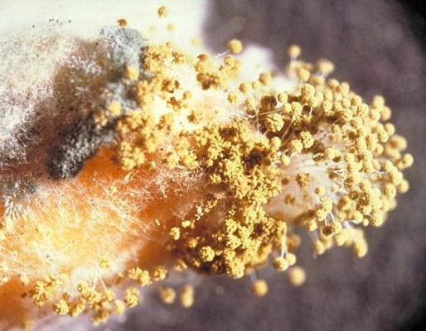
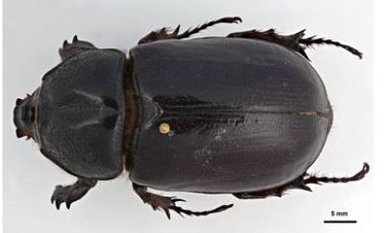
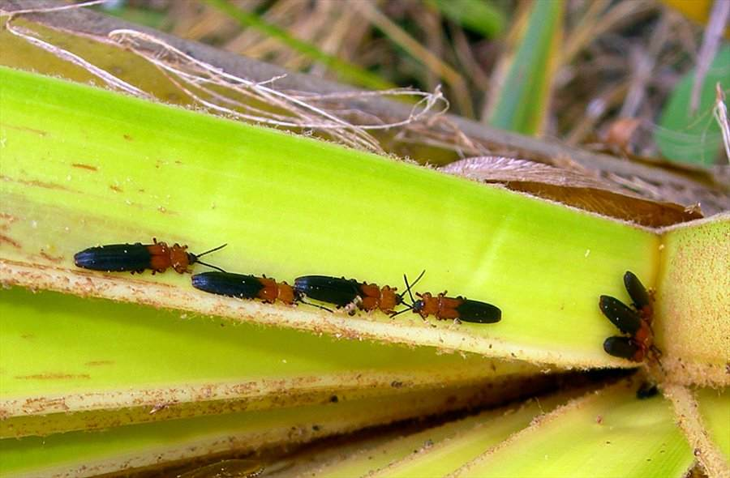
Some coconut pests and diseases – in the Pacific and elsewhere
Zophiuma vector of Finschhafen disorder
Palm weevil host of nematode that causes Red ring disease
Coconut scale
Rhinoceros beetle head, exit holes and leaf damage (CRB-G or CRB-S?)
Coconut termite winged queen & worker
Ants and mealybugs
Coconut spike moth life stages
Ganoderma butt rot fungus
Haplaxias crudus a carrier of a lethal yellowing disease
Palm weevils ( showing colour variation)
Melanesian coconut rhinoceros beetle
Coconut hispine beetle
Aspergillus mould

